Slide 1
Full Stack Development
MERN STACK
Vraj Suratwala
Department of ICT - VNSGU, Surat

Slide 2
Topics :
What is Frontend and Backend ?
MERN Stack Architecture and Components.
Callback Hell
Basic Modules
How to Access Request Headers in Node ?

Slide 3
What is Front-end and Backhend?
Frontend : Frontend development refers to the creation of the user-facing part of a website or web application. It encompasses everything that users interact with directly, including the layout, design, and functionality of the site.
Backend : The back end of a website or application refers to the server-side components that handle the logic, database interactions, and other operations that are not visible to the user.

Slide 4
MERN Stack
The MERN stack is a popular full-stack JavaScript framework for building dynamic web applications.
It consists of four key technologies: MongoDB, Express.js, React, and Node.js.
Each component plays a specific role in the development of a web application, enabling end-to-end JavaScript development.

Slide 5
Components of the MERN Stack
1. MongoDB : A NoSQL database that stores data in JSON-like documents. It’s schema-less, making it flexible for handling large amounts of unstructured data. Used to store application data, such as user profiles, posts, or product details.
2. Express.js (Node Fromework) : A lightweight web application framework for Node.js. Simplifies the creation of RESTful APIs by handling HTTP requests, routing, and middleware. Acts as the backend logic layer, connecting the frontend to the database.

Slide 6
Components of the MERN Stack
3. React (Frontend Library): A JavaScript library for building interactive user interfaces (UIs). Uses a component-based architecture to create reusable UI elements. Manages the client-side of the application, rendering dynamic content to the user.
4. Node.js (Runtime Environment): A server-side JavaScript runtime built on Chrome’s V8 engine. Enables JavaScript to run outside the browser, handling server-side logic. Powers the backend, allowing Express.js to process requests and interact with MongoDB.

Slide 7
Working Flow MERN Stack :
1. User Interaction
2. Backhend Processing
3. Express.js
4. Database Interaction (using API)
5. Response via Node to User

Slide 8
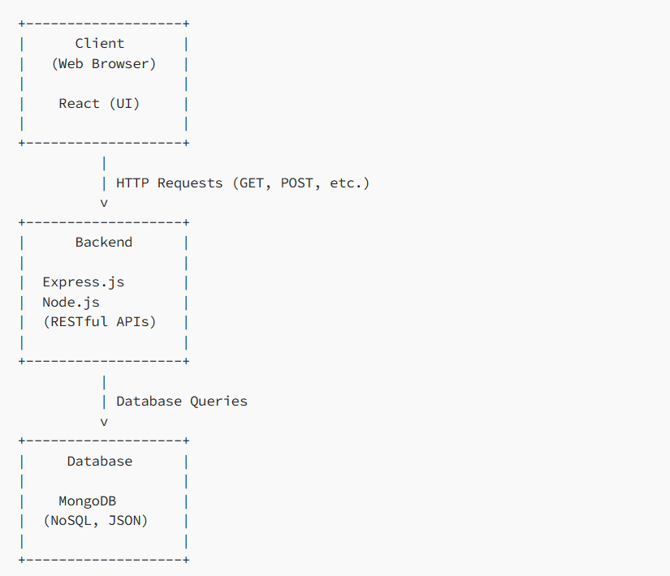
Diagram : MERN Stack Working flow!

Slide 9
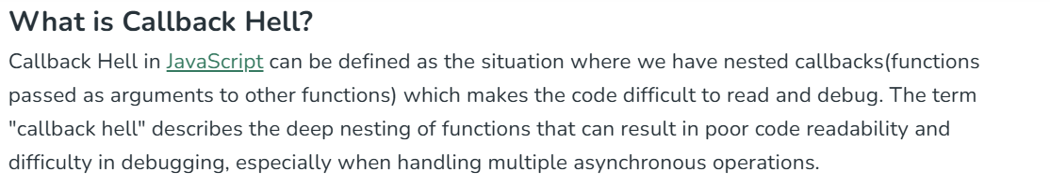
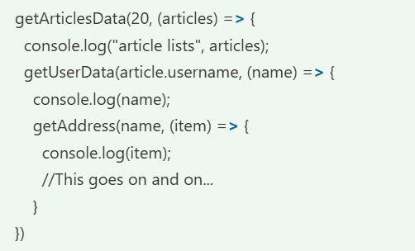
Callback Hell

Slide 10
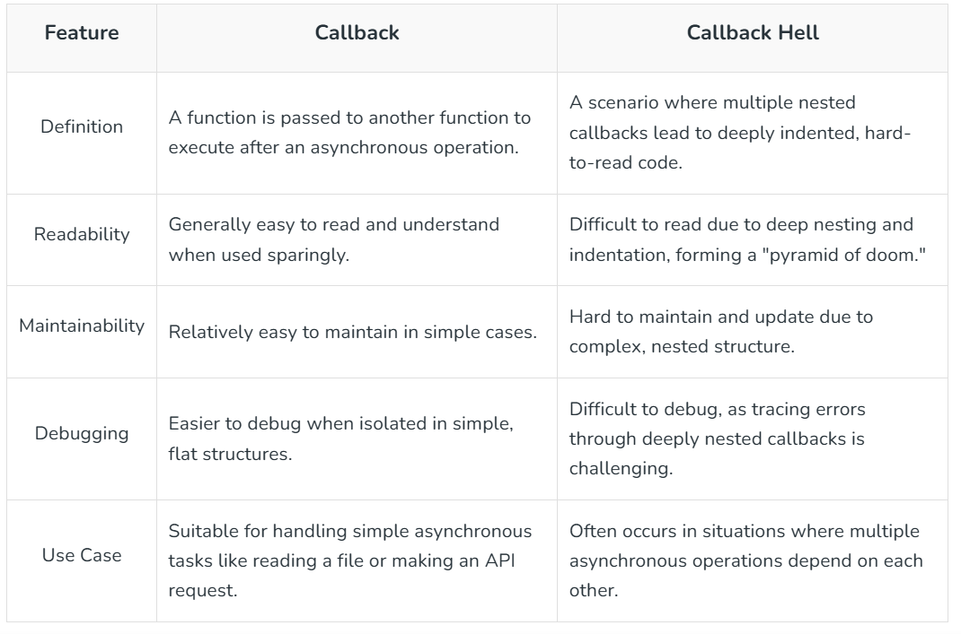
Callback VS Callback Hell

Slide 11
Modules in Node - Basic
1. util : provides various utility fucntion for debugging and working with objects.
Methods :
util.format(): Formats strings like printf in C.
util.inspect(): Converts objects into readable strings, useful for debugging.
util.promisify(): Converts callback-based functions into Promise-based ones.
util.types: Provides type-checking utilities.

Slide 12
2. path module : working with files path and directory path.
Methods :
path.join() - with __dirname
path.resolve()
path.basename()
3. os module : provides operating system related utilities.
Methods :
os.platform
os.cpus()
os.fremem() etc..

Slide 13
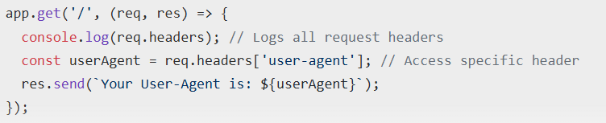
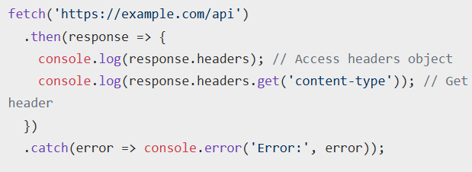
How to Access Request Headers in Node ?
1. In a Server-Side Environment:
2. In a Broweser :
3. Other Way : Using CORS

